Slide 1
Demographics and Debt:
Investigating the Impact of Age Distributions on County-Level Debt-to-Income Ratios in the United States
Al Stamm and Robert Hurly

Slide 2
Project Overview
Objective: Investigate the relationship between county-level age demographics and economic outcomes, focusing on debt-to-income ratios.
Context: Demographic shifts, especially aging populations, create fiscal pressures:
Rising expenditures on retirement benefits and healthcare.
Reduced tax revenue due to an aging workforce.
Hypothesis: A higher proportion of older residents correlates with and may drive higher county-level average household debt-to-income ratios.

Slide 3
Motivation
Understanding Fiscal Health:
Larger elderly populations may lead to increased spending on pensions and healthcare, impacting debt-to-income ratios.
Younger populations may bring different dynamics, such as:
Higher workforce participation.
Increased tax revenues.
However:
Elderly populations on average have larger lifetime savings compared to their younger, work-age counterparts
We thus analyze the data to see which has a larger impact

Slide 4
Data Sources
United States Census Bureau:
Annual Population Estimates (+ age demographics)
Annual Survey of State and Local Government Finances
Federal Reserve: County-Level Debt-to-Income Ratio
Household Debt: FRBNY Consumer Credit Panel/Equifax Data
Household Income: Bureau of Labor Statistics
Bureau of Economic Analysis:
Average state level income and GDP
Quarterly, not County-level

Slide 5
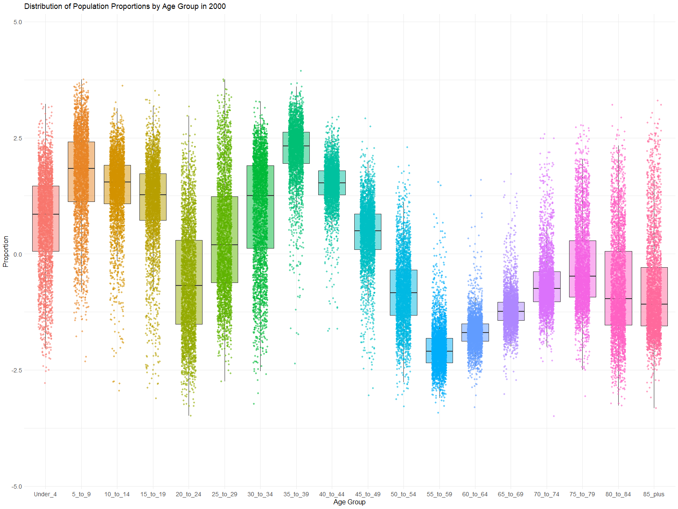

Slide 6
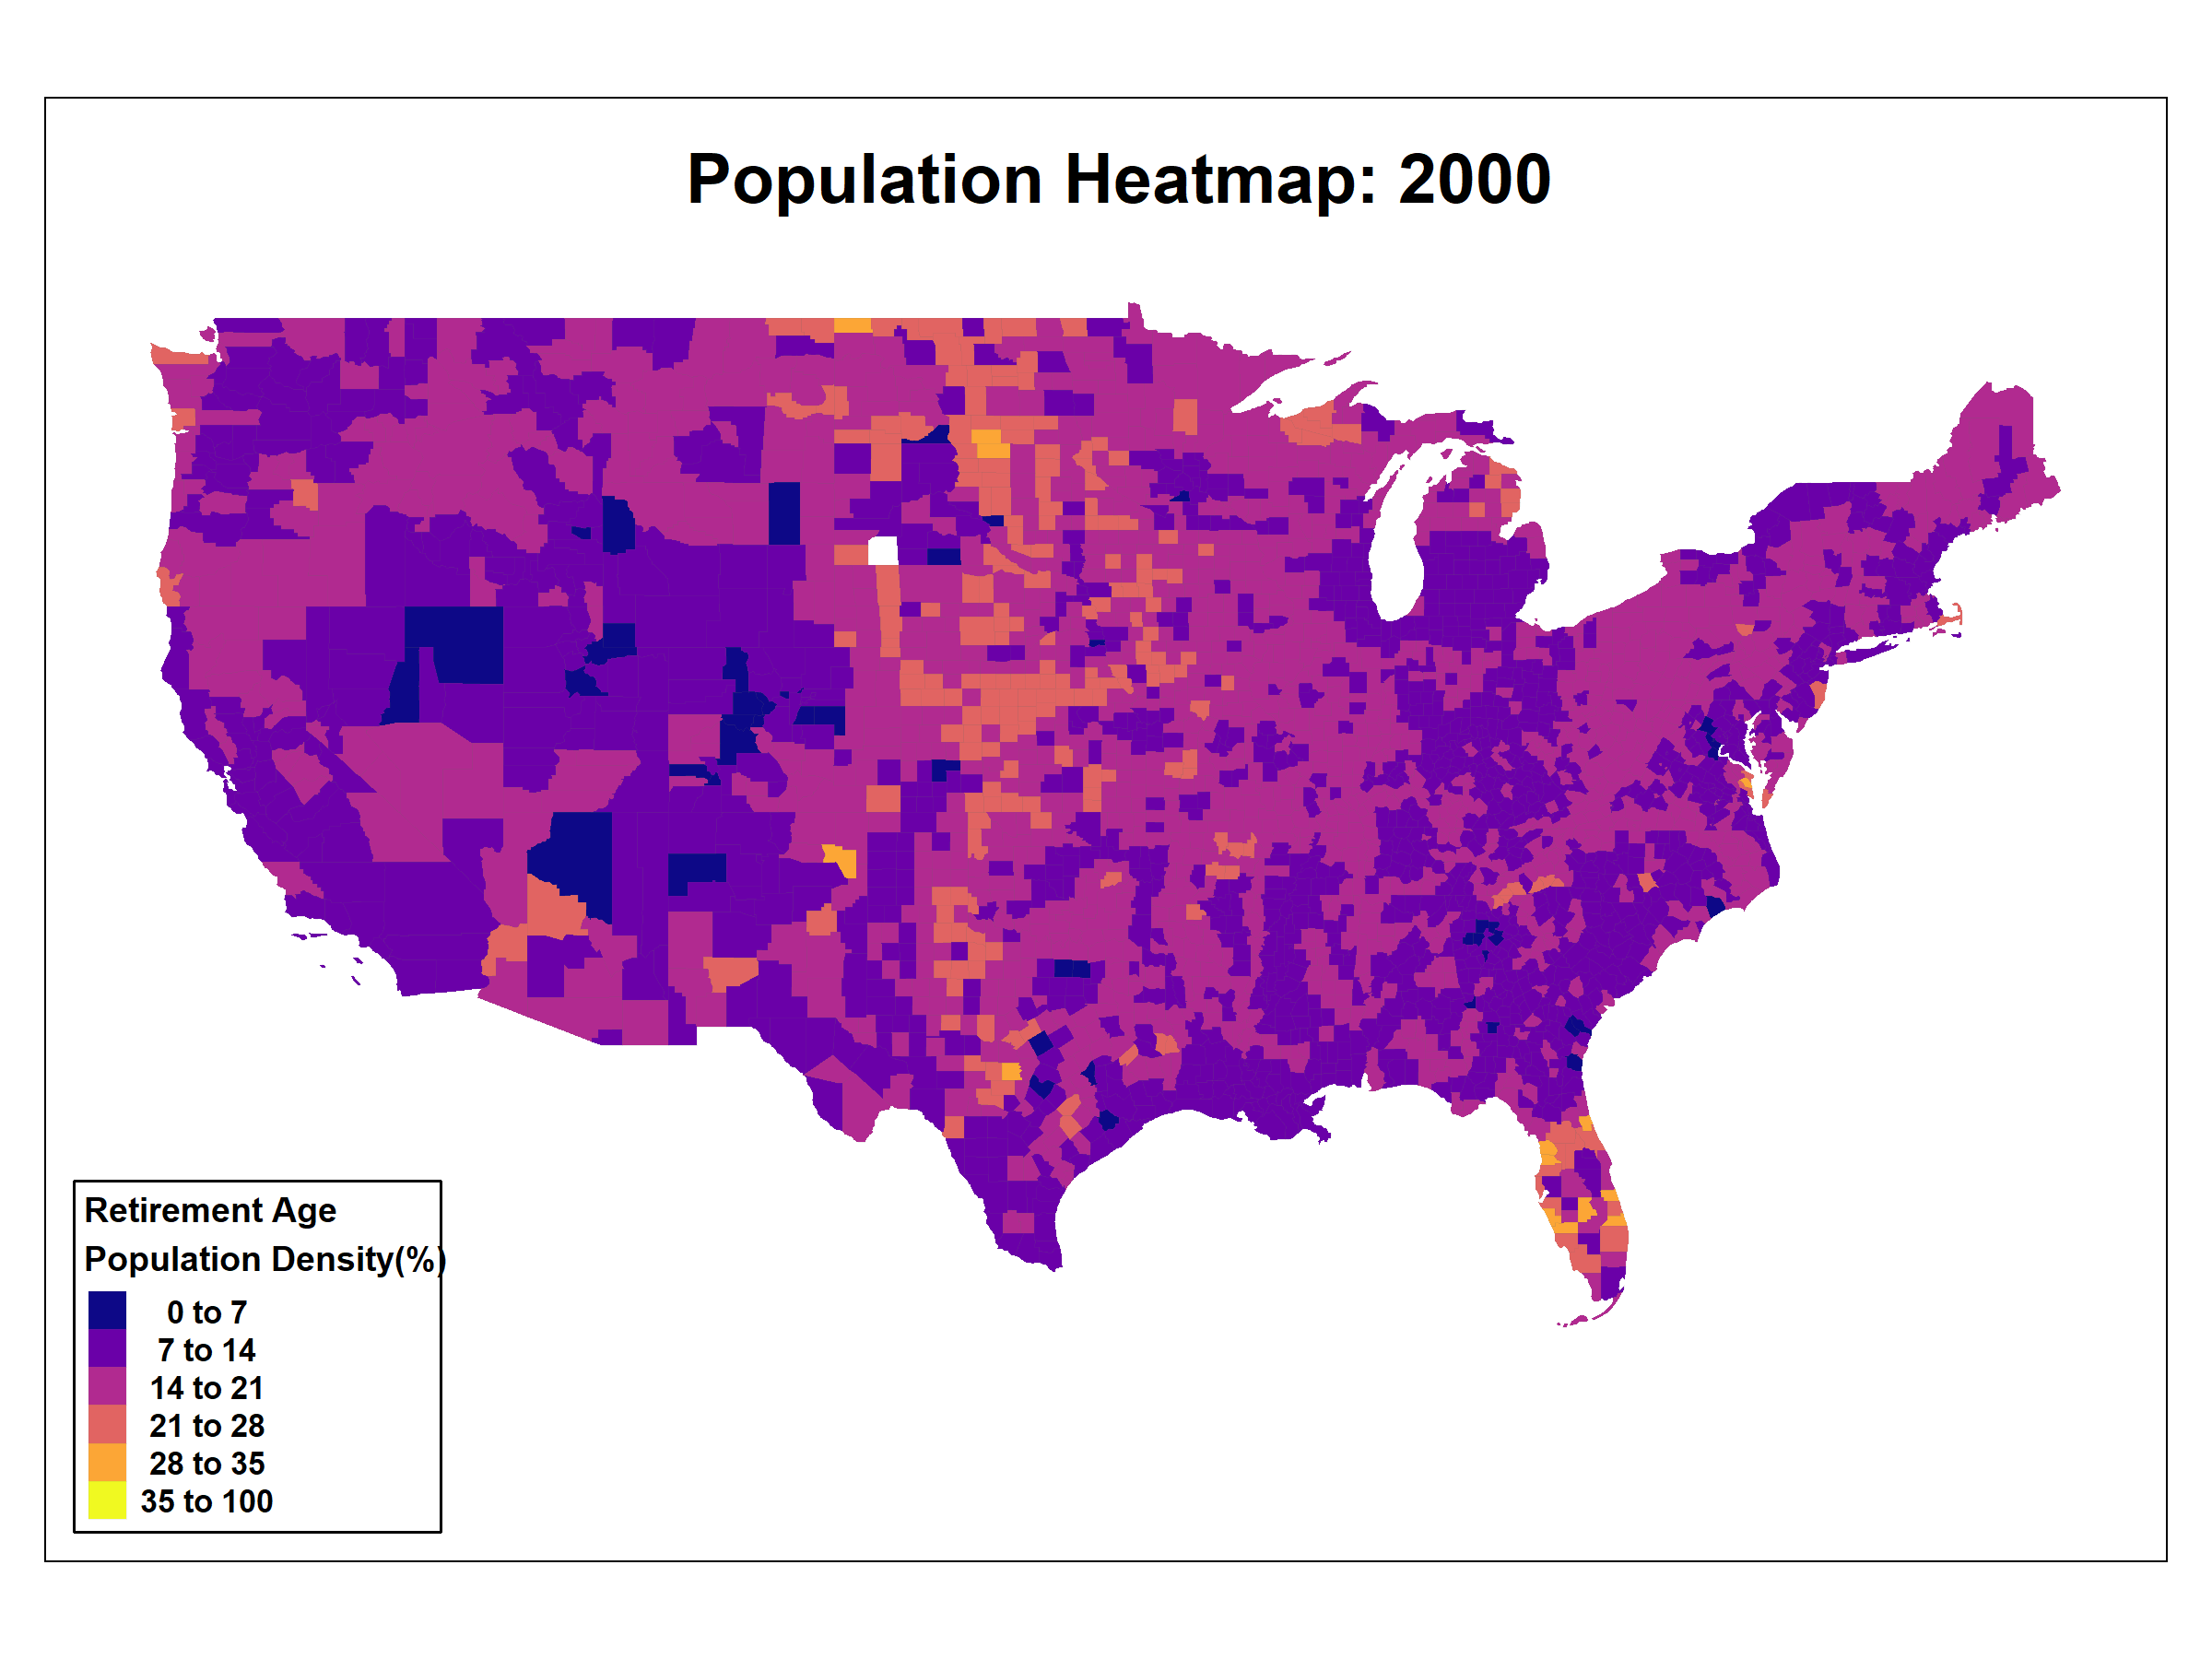

Slide 7
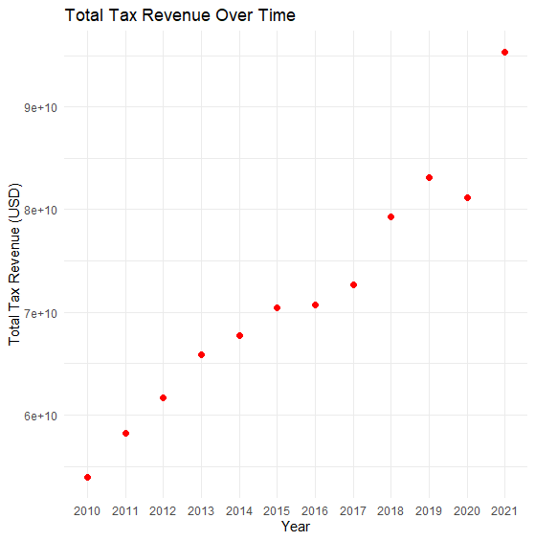

Slide 8
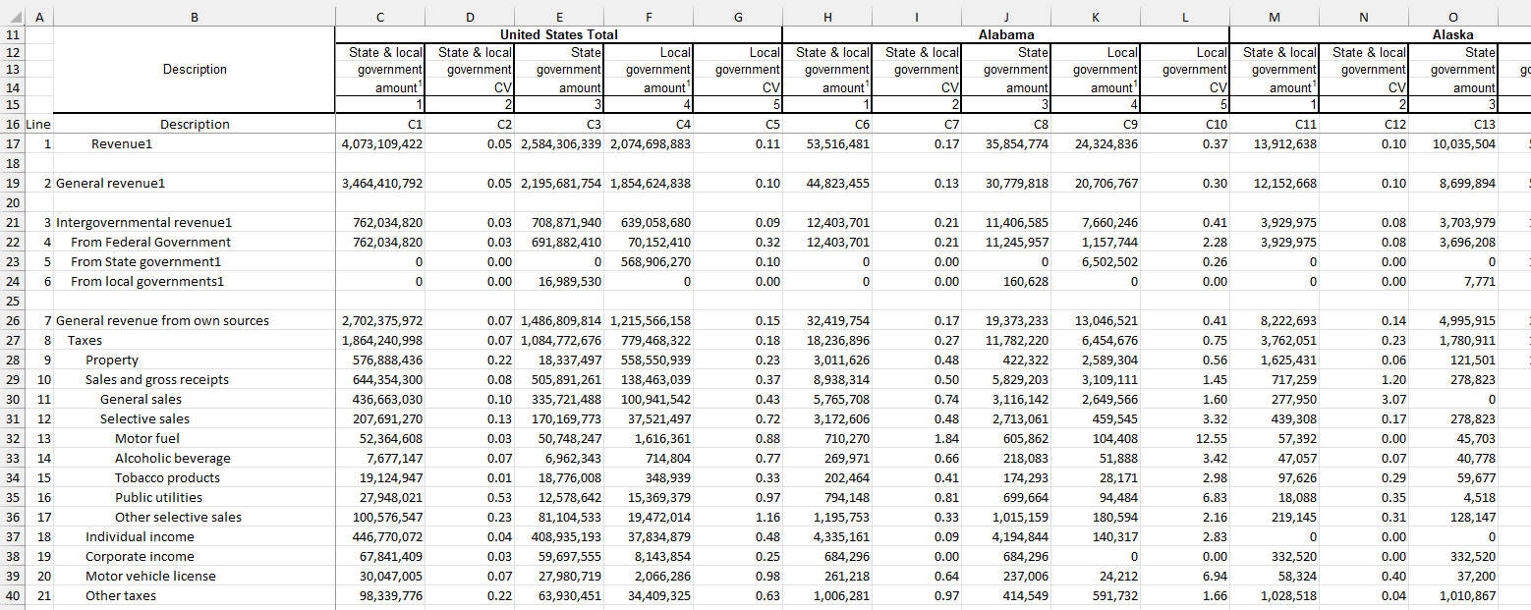
Data Cleaning

Slide 9
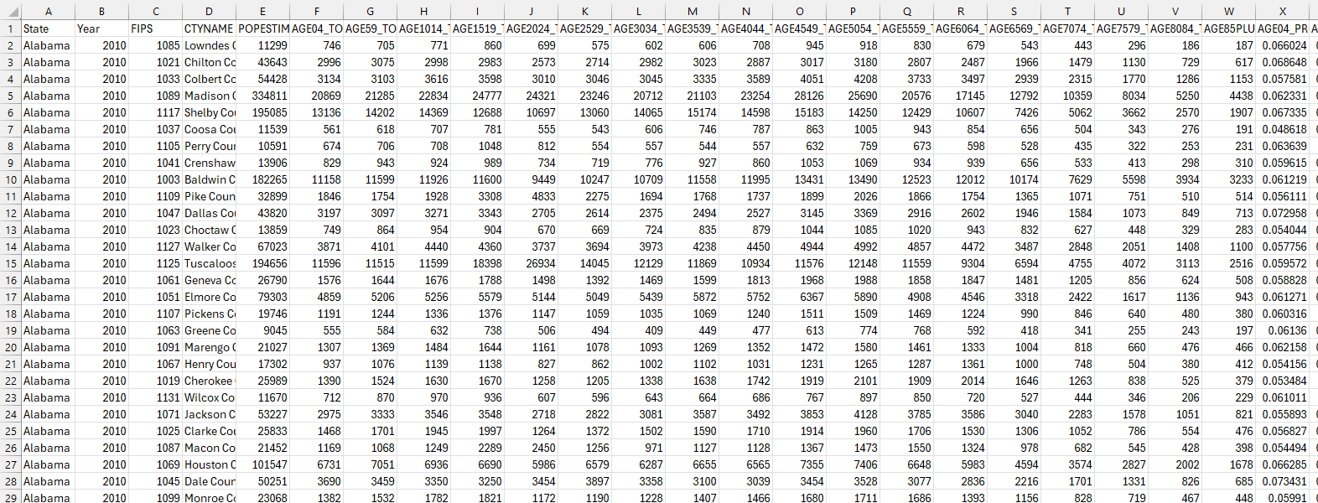
Data Cleaning

Slide 10
Analysis
Part 1: Predictive model using Elasticnet
Idea: Addresses multicollinearity effectively by combining:
Lasso (L1) penalty: Variable selection.
Ridge (L2) penalty: Shrinks coefficients to prevent overfitting.
Identifies key predictors impacting the debt-to-income ratio.
Part 2: Fixed-Effects Panel Regression
Idea: Use the Elasticnet results to narrow down key variables to use in pursuit of causal inference, rather than just predictive modeling

Slide 11
Results
Cross-Validation and Model Fit
Optimal Lambda (from cross-validation):
0.0002784226
Optimal alpha
Rounds to zero ~ indicates that Ridge model provides better fit than lasso
Model Performance:
MSE on Test Set: 0.813388.
Indicates low error and a good fit to the data.

Slide 12
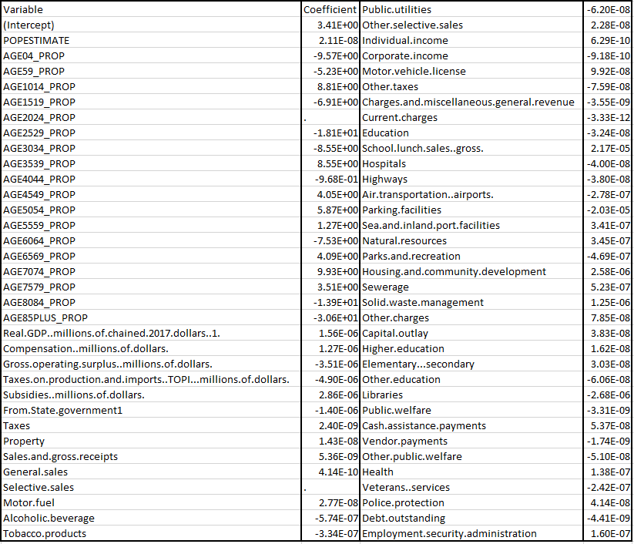

Slide 13
Results cont.
Positive Coefficients:
Age proportion variables from 65-79 are positively correlated with the debt to income ratio
Negative Coefficients:
Variables such as Real GDP negatively impact the debt-to-income ratio.
Stronger GDP performance is associated with lower debt-to-income ratios, indicating better fiscal health.

Slide 14
Results Cont.
Panel Regression:
Extremely high multicollinearity among many of the variables in the dataset
Given our interest in using the elasticnet as a variable selector for the regression, arbitrarily removing enough colinear variables to make the regression work out would be self-defeating.
However:
This provided additional validation to our decision to use elasticnet as a predictive model, given its ability to deal with colinear data, and our interest in the particular demographic variables in our dataset.

